Slide 1

Capstone project-2
By Sakshi Shekhar

Slide 2
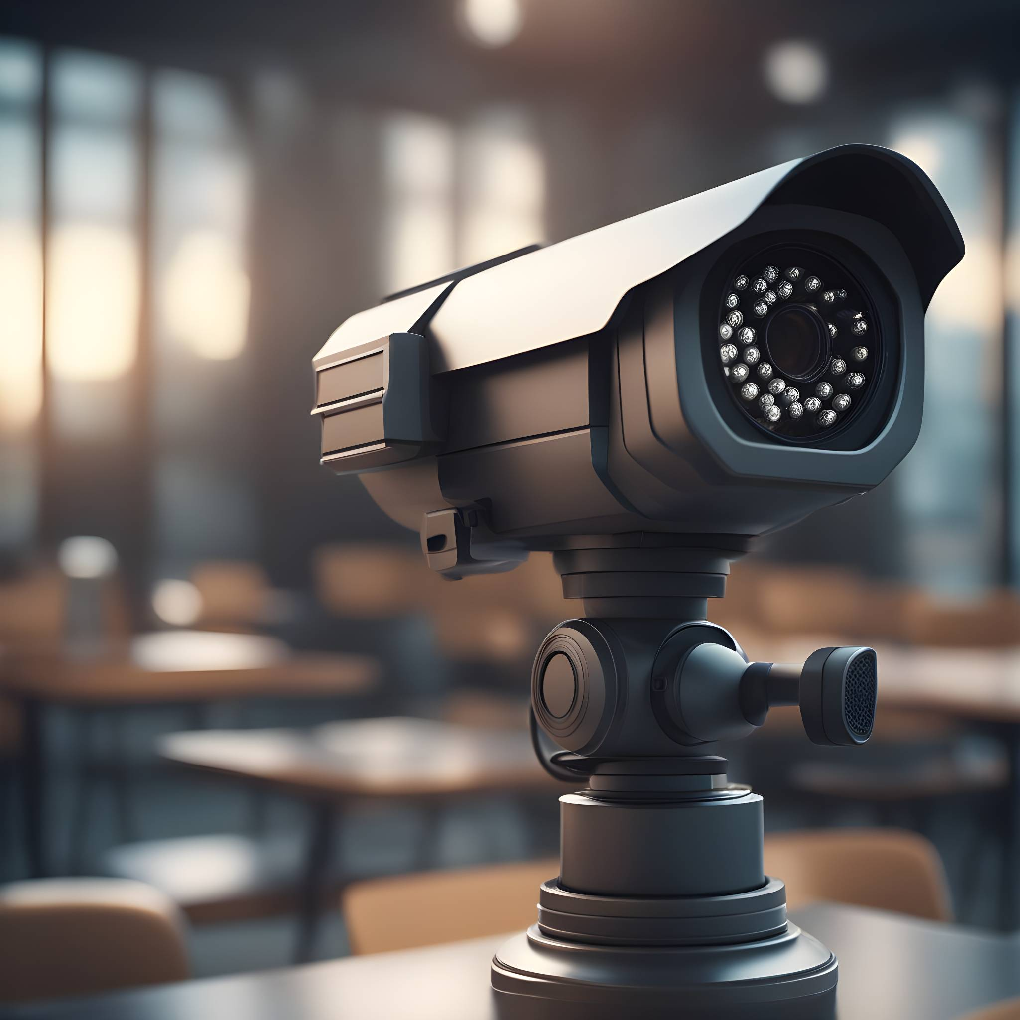
CCTV-based Stranger Detection for Kid Safety
“Deep-Learning - Python Project”

Slide 3

Introduction
the motivation behind the project: Enhancing home security for child safety.
Importance of using technology for surveillance

Slide 4
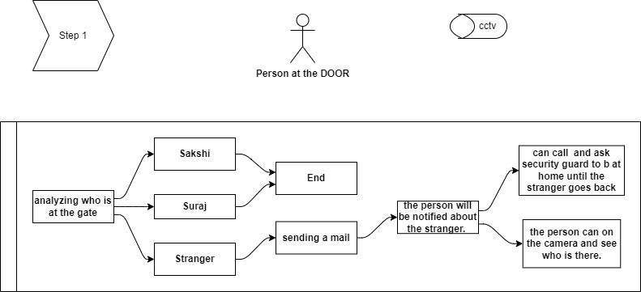
WORKING:

Slide 5
Python coding part:
​
​
​
​
Importing important Libraries for Face Recognition
generating 100 image from 1 image to train my model.
Splitting values to create target variable
Random shuffling of the data
Splitting to TRAIN and TEST
Creating model
Saving model in “.h5” format
Using HaarCascade code for frontal face detection
Using web cam to detect the person
If stranger is found a mail is sent.
​

Slide 6
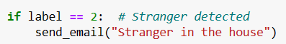
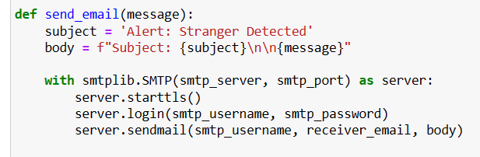
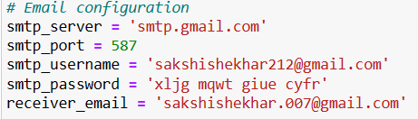
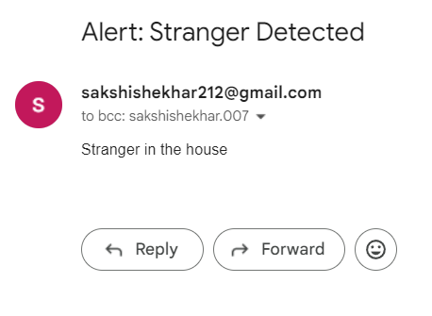
The mail sent by code:

Slide 7
Future goal:
Implement Harashment.
Criminal activity
Any threat to child by known or stranger.

